Slide 1

Introduction to… Global management

Slide 2

Agenda
INTRODUCTION TO THE COURSE
Official requirements and exam
Expectations setting
Exam
Structure of the course
Case solving
GLOBALIZATION
Definition and development over time
Anti-globalization attitudes
Two laws of semi-globalization
CAGE and AAA model
Example

Slide 3
Teaching team
Jakob Lauring, Prof.
jala@mgmt.au.dk
Anna B. Holm, Assoc. Prof.
annah@mgmt.au.dk
Alexandra Valencia Zapata, PhD student
alexandra.vz@mgmt.au.dk

Slide 4
The official requirements
What is the meaning of workload?
By European standards for a course for which you can earn 10 credits, you are expected to work/study 280 hours.
You’re spending 41 hours in the classroom.
239 hours of self-study, case-work and supervision.
About 34 days (x 7 hours)- a month full-time focus on GM course
You need to hand in at least 3 (out of 4) assignments (2 A4 each) individually to attend the exam.

Slide 5

What can I expect from this course?
Classroom lectures- 16
Small exercises, discussions, mini-cases
Mentimeter, quizzes
Videos
Seminar, 4 supervisions, 3 hand-ins minimum
Larger cases
Individual work and group feedback
Reading
Textbook is important- we use almost all chapters
Articles- learn how to read efficiently (no memorization of detailed facts is necessary)
Learn how to build your argument based on scientific literature

Slide 6

SUPERVISIONS
Supervisions will be in writing on Brightspace.
There will be individual written feedback and a possibility to discuss questions with Alexandra online.

Slide 7
Assignment deadlines
You can access the cases and supervision questions from the first day of class.
Feel free to ask any questions about supervision via email at alexandra.vz@mgmt.au.dk. We can find a virtual space to address any doubts regarding feedback from each supervision.
For more information, please review the Supervision section on Brightspace.
# Supervision | Deadline assignment in Brightspace | Feedback
1 | Until October 11th (17:00) | Thursday, 22nd of October. 14:00 – 16:00
2 | Until October 29th (17:00) | Monday, 4th of November. 14:00 – 16:00
3 | Until November 19th (17:00) | Monday, 26th of November. 13:00 – 16:00
4 | Until December 6th (17:00) | Tuesday, 11th of December. 13:00 – 16:00

Slide 8

exam
8-hour take-home assignment submitted via Wiseflow, 7-point scale
Based on a case- so previous casework is a great practice
Open book
Max. 29,000 characters excl. spaces corresponding to 12 A4 pages (2,400 characters per page incl. spaces)
The ordinary exam is on 18.01.24 (take-home assignment), re-exam is on 29.02.24 (oral exam)
Re-exam: Individual 30 min. oral exam. Students who failed to submit the prerequisite assignments during the semester must submit them before being allowed to attend the re-exam
Quality not quantity
Analysis, not copy-paste definitions
Choice of appropriate theory shows you have read and understood what you have read
Good argumentation not just common sense

Slide 9
Why global management?
There is a great demand for ”global” skills:
MNCs are operating across different cultures/countries
How to enter and compete in a new market? (Exporting, joint venture, subsidiary)
How to manage presence in multiple markets at the same time?
MNCs are hiring increasingly diverse talent
How to recruit and retain the best international talent?
How to motivate and lead diverse employees?
How to handle the huge portfolio of globally mobile individuals?
How to organize and manage culturally diverse and global virtual teams?
Domestic firms face multicultural environment at home
Should firms operating just in the domestic environment switch to common corporate language? (English) what would that cause?
How to deal with diverse customers?

Slide 10



Themes of the course: block 1
Introduction to the GM course (and globalization)
Understanding culture in global management (what is culture – how does it affect work behavior?)
Cross-cultural communication and multilingual organizations (verbal/non-verbal, implications of one lingua franca in an organization)
Culture and digitalization (the role of digitalization and virtuality in conducting global business).
Intercultural business negotiations (how culture affects international business negotiations)

Slide 11


Themes of the course: block 2
Internationalization of the firm (market seeking, resource seeking, efficiency seeking) and entry modes (exporting, franchising, joint ventures, strategic alliances, subsidiaries)
Internationalization strategy (global, multi-domestic, transnational), types of MNCs based on int. strategy (ethnocentric, polycentric, geocentric)
MNC structure and control (e.g. types of structures, aligning strategy, structure and control)
International business models

Slide 12



Themes of the course: block 3
IHRM strategies and practices (Managing expatriation and repatriation)
Recruitment and retention in MNC (Staffing global operations as a means to support strategy)
Talent management and global careers I (What is GTM; drivers, challenges, and practices of GTM, career capital, GTM of self-initiated expatriates)
Managing multicultural teams
Knowledge sharing within MNC (expatriates as agents of information transfer)
Leading and motivating people from around the world

Slide 13
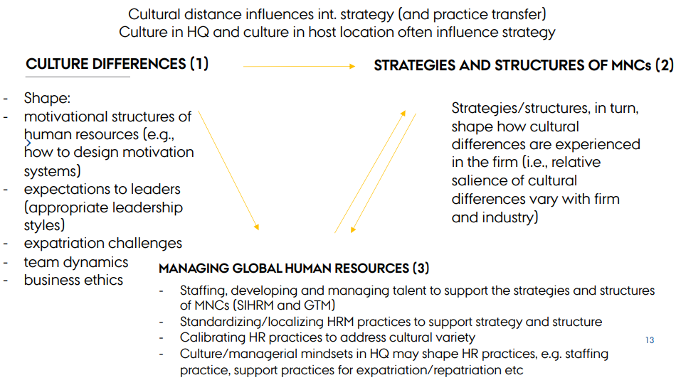
Connection between the themes

Slide 14
case studies
”It is only because of experience with cases that one can at all move from being a beginner to being an expert. If people were exclusively trained in context-independent knowledge and rules… they would remain at the beginner’s level in the learning process. Common to all experts is that they operate on the basis of intimate knowledge of several thousand concrete cases in their areas of expertise” (Flyvbjerg, 2004)

Slide 15
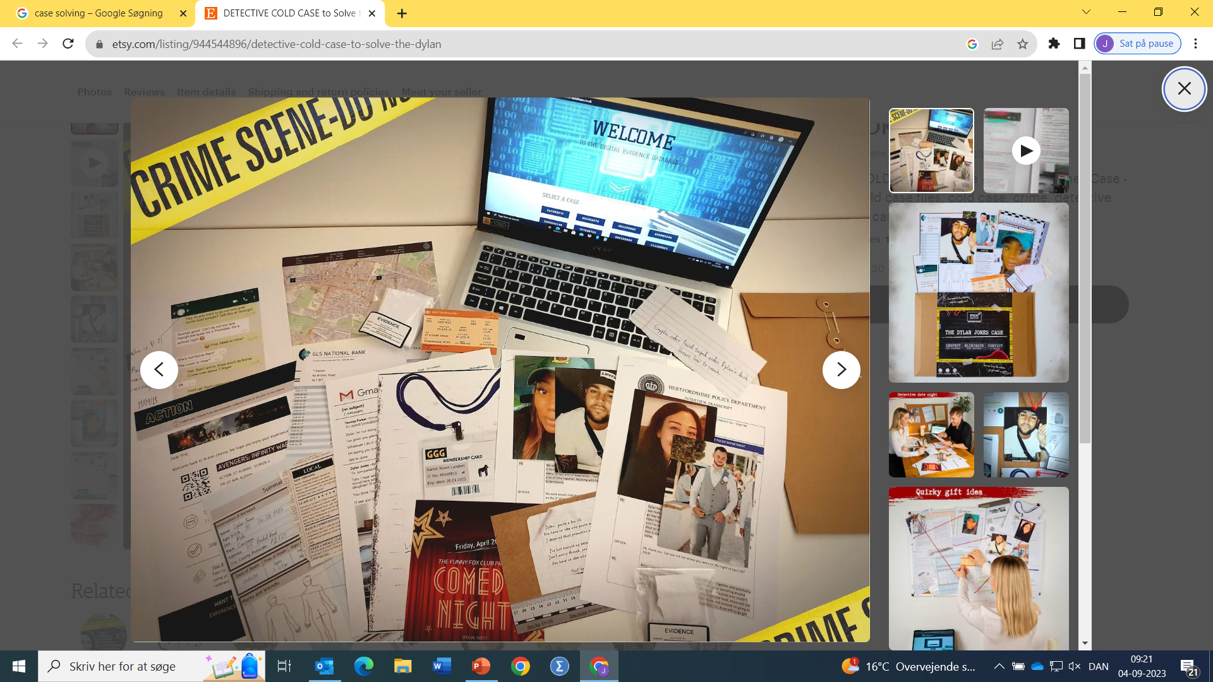
How to prepare yourself
Prepare – read the theory and case material available on Brightspace
Participate – Join the discussion in class as this increases your learning and also prepares you for your future job

Slide 16

What does a case contain?
A case can consist of multiple information on the current state often presented in a relatively messy way to resemble reality.
Sometimes future objectives or desired states are mentioned. If that is not so, you may use theory to inform you of a desired future state.
There will often be a gap between the current state and a desired situation.

Slide 17

Identifying the problem
Read the case – first quickly and then more carefully
Shortly describe the situation including the most important information
What is at risk?
Often the actual problem is not directly visible. What you can see are several different symptoms of the underlying problem.
Extract data as proof for your assumptions

Slide 18

Apply theory
Use theories to develop a deeper understanding of the causes behind the current situation
Evaluate different theories that can give you different understandings of the situation
Describe what would be the results of using a different theoretical perspective

Slide 19
Recommendations for practice
Solution: This section could include a couple of different options for interventions
Reasons: State the critical reasons for your decision – supported by theory and data/case material
Support required: Potentially discuss what the case company will need to achieve its goals.
Discuss alternatives: Could other things have been done? What could be the downsides of the chosen action?

Slide 20

globalization

Slide 21

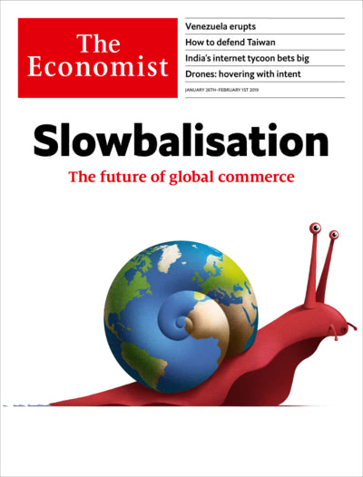
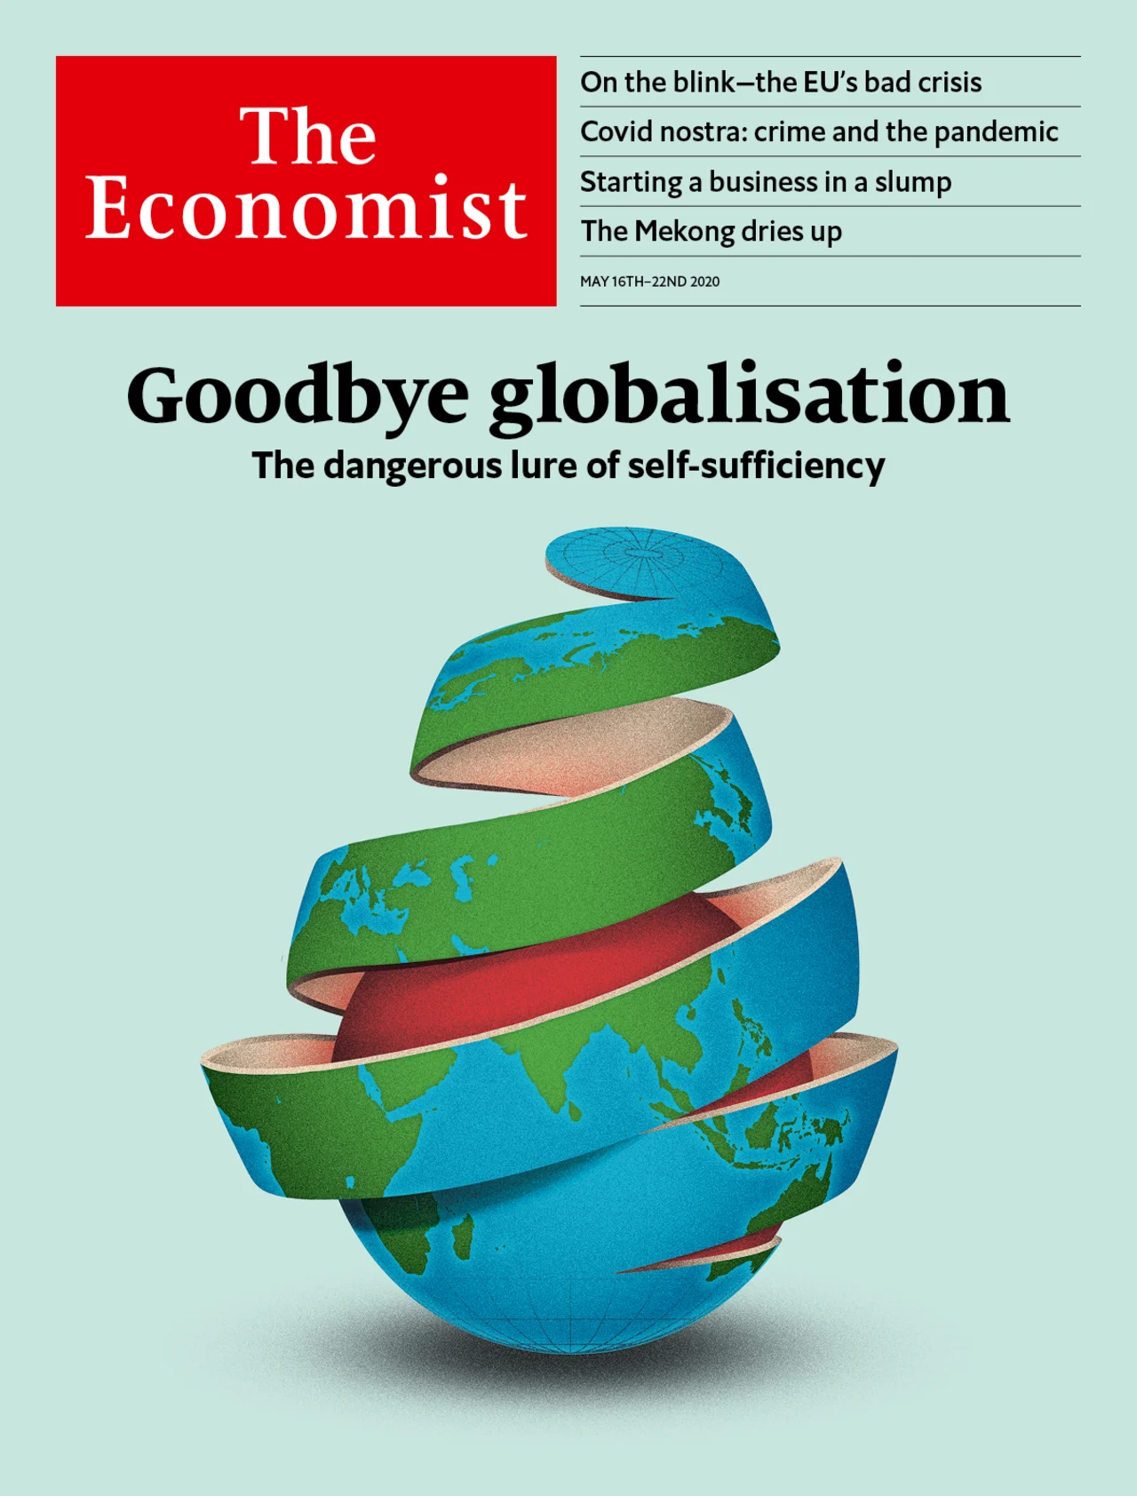
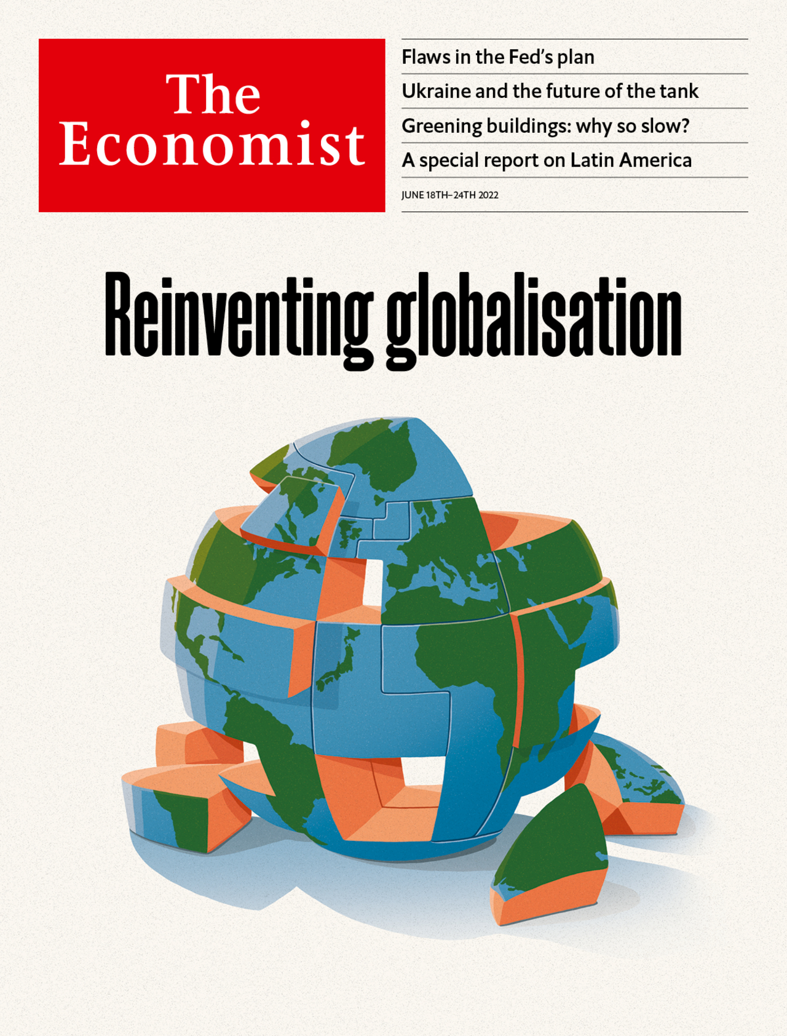
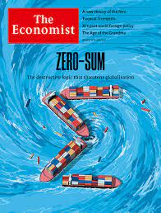
Why is globalization relevant to understand?
The extent of globalization impacts how managers should prepare strategies and make decisions - adjust to differences or ignore them?
Globalization poses challenges/boundaries to application of general management theory (everything you are taught in business school- OB, HRM, strategy etc.)
Notes:
The world is flat- Thomas Friedman was first published in 2005
The Economists covers from left to right- 2006, 2019, 2020, 2022, 2023

Slide 22
Globalization
Both homogenization and diversification
Old…very very old- transnational systems have existed for centuries
Contemporary globalization has distinctive characteristics- enhanced communication technology, travel possibilities, spread of capitalism, and Western influence
Tends to create winners and losers of different regions, industries, organizations, and individuals- but that is true for many trends
It has economic and technological drivers but has more dimensions than that
Notes:
Cultural diversification under globalization:
Additionally, Yi Wang (2007) explained that globalization actually enhanced cultural identity. From this author's point of view, the welcoming of new cultures has enabled individuals to become more self-aware of cultural identities than before. Globalization could lead to a sense of ‘togetherness’ rather than homogenization. Globalization could be seen as the enabler behind cultural identities. In other words, thanks to technology, there is extensive and accessible information about different cultures, and people can now learn and educate themselves without necessarily traveling.
Also diversification as a strategy- need something to set yourself apart from all the other companies that are now competing with you, so instead of having a leading furniture company doing the same in each country, we have a Swedish company that specializes in affordable furniture for the whole world, minimalistic, high quality furniture companies from Denmark, ultra-luxurious ornate furniture from Italian and French companies…
First MNCs- started with colonization-1600- finished in 18th century
The history of multinational corporations began with the history of colonialism. The first multinational corporations were founded to build set up colonial "factories" or port cities.[5] In addition to carrying on trade between the mother country and the colonies, the British East India Company became a quasi-government in its own right, with local government officials and its own army in India .[6][7] The two main examples were the British East India Company, and the Dutch East India Company (VOC). Others included the Swedish Africa Company, and the Hudson's Bay Company.[8] These early corporations engaged in international trade and exploration, and set up trading posts.[9]

Slide 23
Dimensions of globalization
Globalization is interdependence of business, politics, trade and finances and technological environment around the world. Have resulted in the free movement of goods, people, money and information across borders (Deresky, chpt 1, pg 22)
Economic and political integration- growing integration and interdependence of national economies, belonging to the same trade pacts, creating supra-national instutions to oversee and limit collective action.
Technological development- especially information technology- integration of networks enabling global exchange and flows of information.
Cultural dimension- homogenization of culture- cosmopolitanism.
Notes:
Supranational institutions-
UN and IMF International Monetary Fund monitors the international monetary system and global economic developments to identify risks and recommend policies for growth and financial stability. The Fund also undertakes a regular health check of the economic and financial policies of its 190 member countries.
WTO World Trade Organization
WHO World Health Organization
NATO The North Atlantic Treaty Organization, also called the North Atlantic Alliance, is an intergovernmental military alliance between 31 member states – 29 European and two North American.

Slide 24
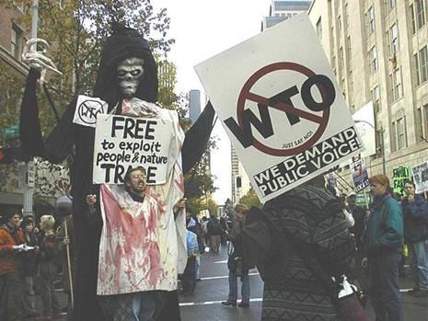


Anti-globalization sentiment
WEALTHY COUNTRIES
Some segments of the population (often correlated with education and income) blame globalization for causing job loss
Protectionist responses to unprecedented rise of competition from developing
Fear of global capitalist system- supranational institutions dictating policies
DEVELOPING COUNTRIES
Exploitation of local resources without giving back
Unethical business practices
Import of foreign products perceived as threatening to local identity, culture, practices
Cultural appropriation- another way to steal

Slide 25
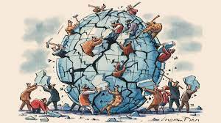
We live in an unevenly globalized world
Most of economic activity is not truly global yet
Cross-border interaction is still hard and different
There are still business opportunities and threats when crossing borders, there are gains from additional integration of MNC operations, but also complexities to deal with
”For many companies, the greatest challenge may be fostering the human capacity to connect and cooperate across distance, internally and externally.” (Ghemawatt, 2011)

Slide 26

Semi-globalization- two laws
The law of semi-globalization: International business activity, while significant, is much less intense than domestic activity.
The law of distance: International interactions are dampened by distance along cultural, administrative, geographic, and, often, economic dimensions.
Ghemawatt’s understanding of distance and how to overcome it
Distance can be understood through CAGE framework
Unique considerations for bilateral relationships between domestic and a specific foreign market instead of universal understanding of distance
Shorter CAGE distance leads to more cross-border interaction, but significance of each type of distance varies between industries

Slide 27
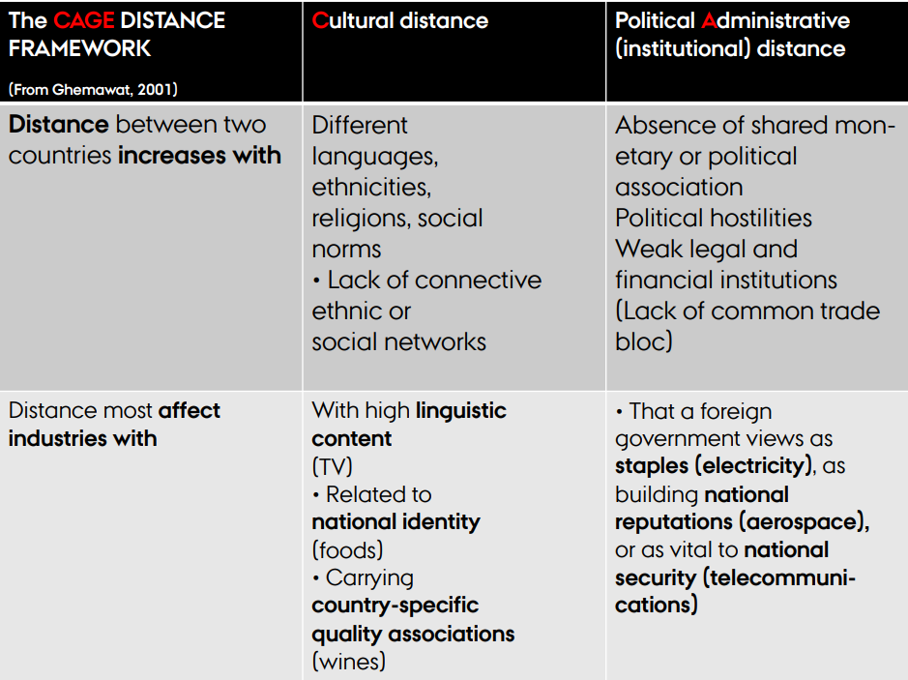
cage
Tool to help managers understand which market is more/less attractive depending on the distance (and the specific industry).

Slide 28
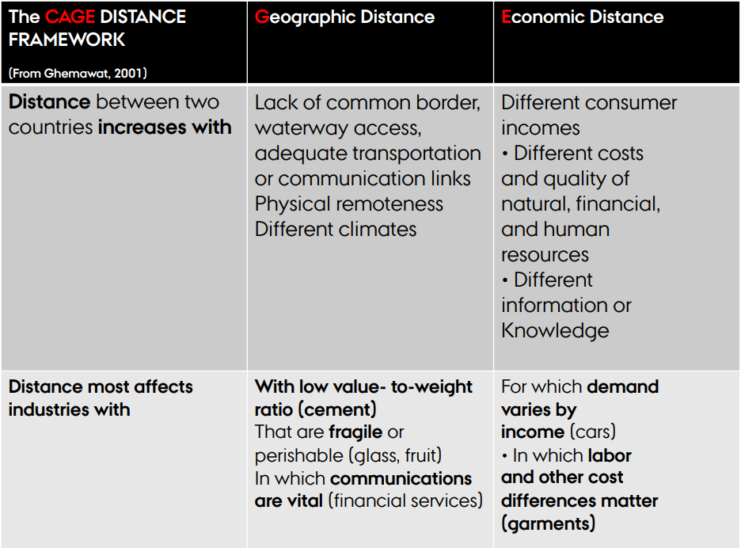
cage

Slide 29
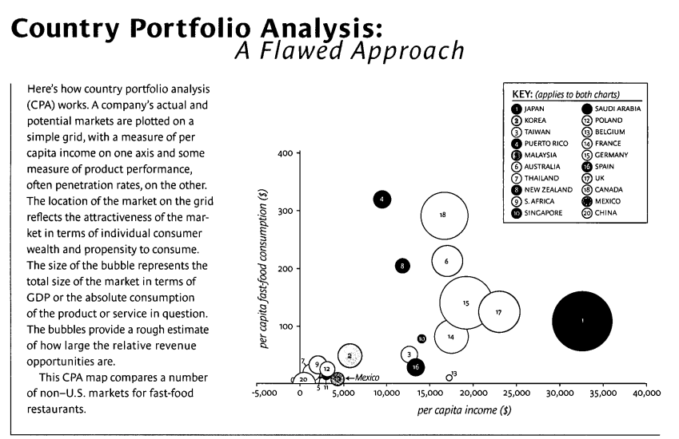
How distance changes strategic markets

Slide 30
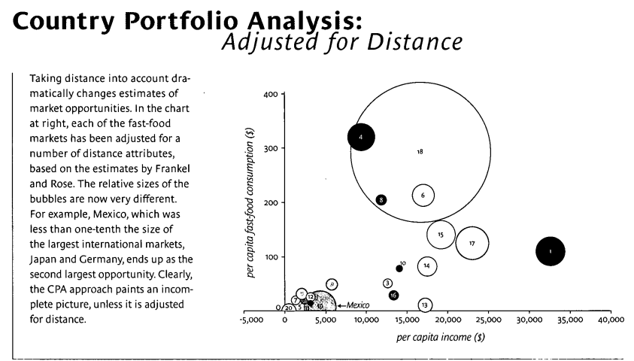
How distance changes strategic markets

Slide 31
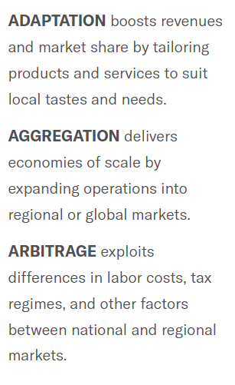
Strategies to overcome distance
Adaptation (multi-domestic) and Aggregation (global) can be used to overcome distance from different perspectives
Arbitrage is exploiting distance- a cheap strategy that doesn’t depend on economies of scale/production quantities
Challenges: Adaptation as costly, Aggregation as lacking local responsiveness, Arbitrage as complex to manage and risky

Slide 32
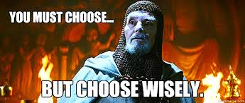
What to choose?
Ideally, select only one…
Adaptation is typically prioritized by companies entering culturally diverse markets where local responsiveness is crucial.
Aggregation suits firms looking to standardize and achieve scale across regions with similar demands.
Arbitrage is ideal for firms that can benefit from differences in market conditions, such as cost structures or resource availability.

Slide 33
Questions
Discuss Netflix in relation to its strategy towards overcoming distances.
Consider each of the four distances in the CAGE and use the AAA framework
What strategies do Netflix use?

